Slide 1
Chapter 5: Assembly Language and the PEP/8 Virtual Computer Part 2
Notes:
Ok – Are you ready for the rest of the story?

Slide 2
Problems with Assembler so far…
Programmer must know where the data is in memory
Data goes at the bottom of memory, must write program before know where data goes
if you insert an instruction later all data addresses change
Single digit decimal input/output is tedious
CHARI/CHARO handle a single character, not numbers
Notes:
In Part 1, we identified these problems with writing assembly code.
The programmer must know where the data is in memory.
Since the data goes at the bottom of memory, we must write program before we know where data goes.
Then, if you insert an instruction later, all the data addresses change.
Also, single digit decimal input/output is a pain! CHARI/CHARO handle a single character, not numbers.
Let’s look at the solutions to these problems.

Slide 3
Solution: New Instructions BR, DECI, DECO
New instruction: unconditional branch
Instruction specifier: 0000 010a
Mnemonic: BR
Jumps to a different memory location for the next instruction to be executed
PC<- {Oprnd}
BR 0005 ; branch around data
Places the operand (0005) into PC.
Result: next instruction executed is at memory location 0005
Notes:
One solution will involve three new instructions BR, DECI, & DECO
The first one BR is an unconditional branch. It jumps to the memory location in the Operand by placing it in the PC or program counter.
There fore the next instruction that is loaded & executed is as the memory location indicated.

Slide 4
Unconditional Branch
New instruction: unconditional branch
Instruction specifier: 0000 010a
Mnemonic: BR
Default: immediate addressing.
If you do not specify addressing mode, assembler assumes immediate addressing.
Assembler places 000 in the addressing mode bits.
Notes:
For this instruction, immediate addressing is assumed if none is specified.

Slide 5
Branch
Correct operation of BR depends on details of von Neumann execution cycle
fetch increment execute repeat
Not
fetch execute increment repeat
Notes:
The correct operation of branch is dependent on the order of the von Neumann cycle.
Note, the program counter is incremented BEFORE the execution of the instruction.
This may have seemed odd before, however it is critical that it happen in this order for the branch to the location indicated.
If the increment came after the execution, the location indicated by BR would be incremented and the program would branch somewhere else.

Slide 6
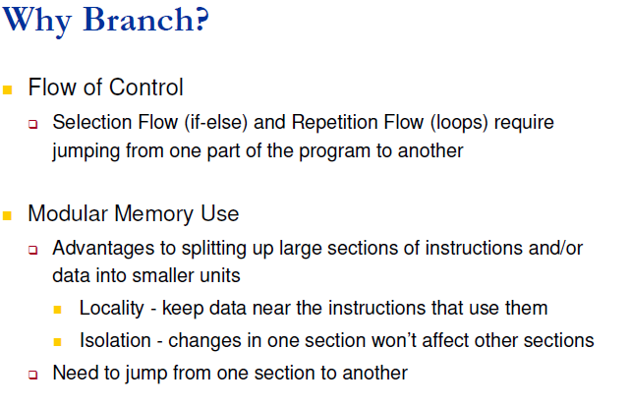
Branching
Notes:
Branching has several uses in assembly language.
It allows the programmer to control the flow of the program for if-else statements or for loops
It also allows the program to be written modularly.
The GoTo statement is controversial in higher level languages, however it is needed at this level.

Slide 7
DECI and DECO
Do not exist at machine level
Provided by the OS
DECI: decimal input.
Converts sequence of ASCII digit characters
To a single word
In 2’s complement representation
DECO: decimal output.
Converts 2’s complement representation
Of a word
To sequence of ASCII characters
Notes:
Here are two more instructions to solve our problems.
DECI & DECO which stand for decimal in and decimal out.
These do not exist at the machine level and are provided by the OS.
DECI converts a sequence of ASCII digit characters to a single word in 2’s complement representation.
DECO converts a 2’s complement representation of a word to a sequence of ASCII characters.
Yay! This is better than the Programmer Calculator that I hope you have all discovered on your computer.

Slide 8
DECI and DECO
DECI: The decimal input instruction
Instruction specifier: 0011 0aaa
Mnemonic: DECI
Convert a string of ASCII characters
from the input device
into a 16-bit signed integer (corresponds to the 2’s complement representation of the value)
stores it into memory
Oprnd <- {decimal input}
Notes:
More specifically, DECI converts a string of ASCII characters from the input device into a 16-bit signed integer (corresponds to the 2’s complement representation of the value) and stores it into memory

Slide 9
DECI and DECO
Notes on DECI: decimal input
Any number of leading spaces or line feeds
First printable char: digit or + or –
Following char must be digits
Sets Z to 1 if input 0 and N to 1 if input negative
Sets V to 1 if input a number out of range (–32768 to 32767)
Does not affect C bit.
Notes:
Here are some notes on DECI:
It may have any number of leading spaces or line feeds
The first printable character must be a digit or + or –
And the following characters must be digits.
It sets Z to 1 if input 0 and N to 1 if input negative
It sets V to 1 if input a number out of range (–32768 to 32767)
However it does not affect C bit.

Slide 10
DECI and DECO
DECO: decimal output.
Instruction specifier: 0011 1aaa
Mnemonic: DECO
Convert a 16-bit signed integer
from memory
into a string of ASCII characters
sends the string to the output device
{decimal output} <- Oprnd
Notes:
DECO converts a 16-bit signed integer from memory into a string of ASCII characters and then sends the string to the output device

Slide 11
DECI and DECO
Notes on DECO:
Prints a – for negative but does not print +
Does not print leading 0’s
Outputs minimum number of digits possible to represent the value
You cannot specify field width
Does not affect NZVC bits
Notes:
Here are some Notes on DECO:
It prints a – for negative but does not print +
And it does not print leading 0’s
Outputs minimum number of digits possible to represent the value
And you cannot specify field width
It does not affect any of the status bits

Slide 12
DECI and DECO
Example
DECI 0003,d ; get a number
With input
–479
Converts the number to
1111 1110 0010 0001 (bin)
And stores it in
Mem[0003]
Notes:
Here is an example of DECI, where the number -479 is input and converted to two’s complement.
This is stored at memory location 0003

Slide 13
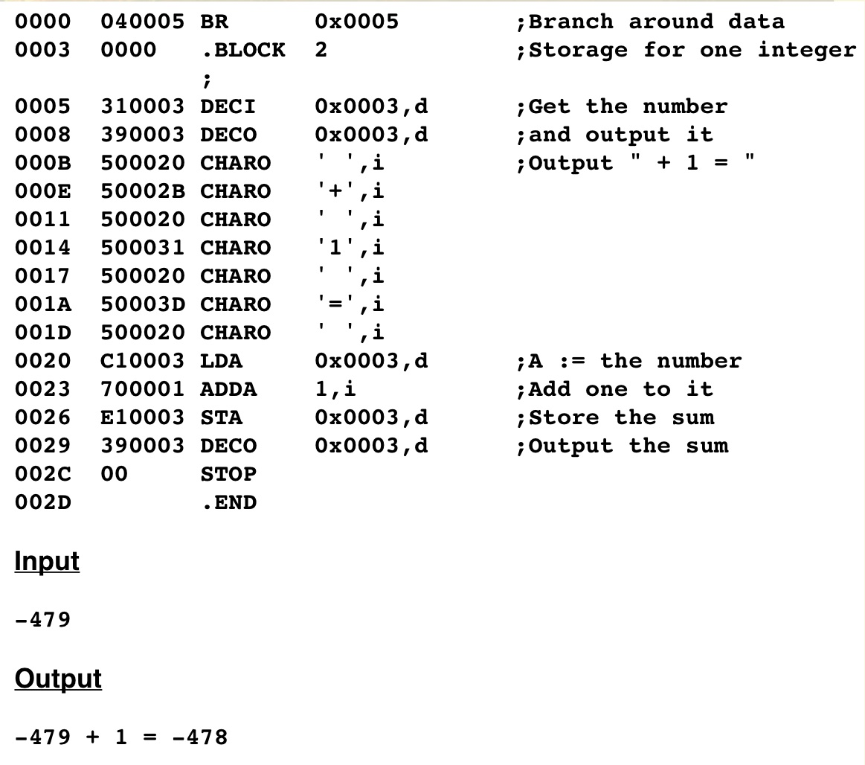
A program to add 1 to a decimal value. It illustrates Decimal I/O and Branch
Notes:
This program has examples of all three of the new instructions.
BR is used to branch around the storage for one integer.
DECI is used to input -479 and store it in location 0003
DECO is used to output the original input value and then again to output the result after adding 1.
Now we need a way to handle a string of characters.

Slide 14
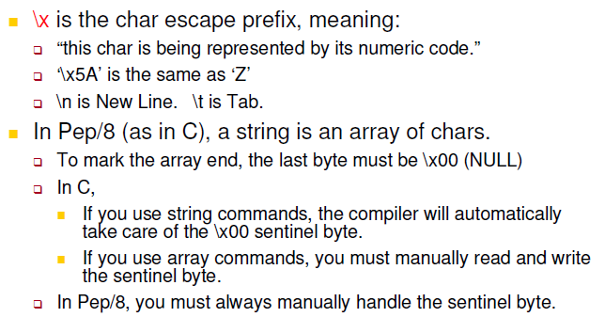
Special characters and strings
Notes:
First, here is the way to represent some special characters.
The backslash x is used to indicate a character is being represented by its ASCII hex code.
\n is for new line and \t is for tab. Some of you use these already.
In Pep/8 a string is an array of characters and the end of the array is marked with \00.

Slide 15
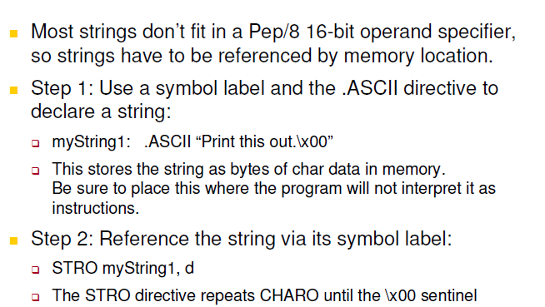
Special characters and strings
Notes:
So to handle a character string, you use a symbol label and the .ASCII to declare the string. The string must be enclosed in double quotes and it must end with \x00
STRO or String Out can reference that string and output it by repeating CHARO until the \x00 is reached.

Slide 16
STRO
STRO (string output)
Instruction specifier: 0100 0aaa
Mnemonic: STRO
Does not exist at machine level
Triggers a trap to the OS when executed
Allows you to output an entire string
Send a string of null-terminated ASCII characters to the output device
{string output} <- Oprnd
Notes:
STRO triggers a trap to the OS that sends a string of characters to the output device.
The program on the following slide

Slide 17
STRO
Notes on STRO
Operand is a contiguous sequence of bytes
Each is interpreted as an ASCII character
Last byte must be a byte of all 0's
Outputs all bytes up to (but not including) the sentinel 00
Notes:
Some notes on STOR, the operand is a contiguous sequence of bytes that will be interpreted as ASCII characters.
All of the bytes will be output up to but not including the sentinel 00
Let’s look at an example…

Slide 18
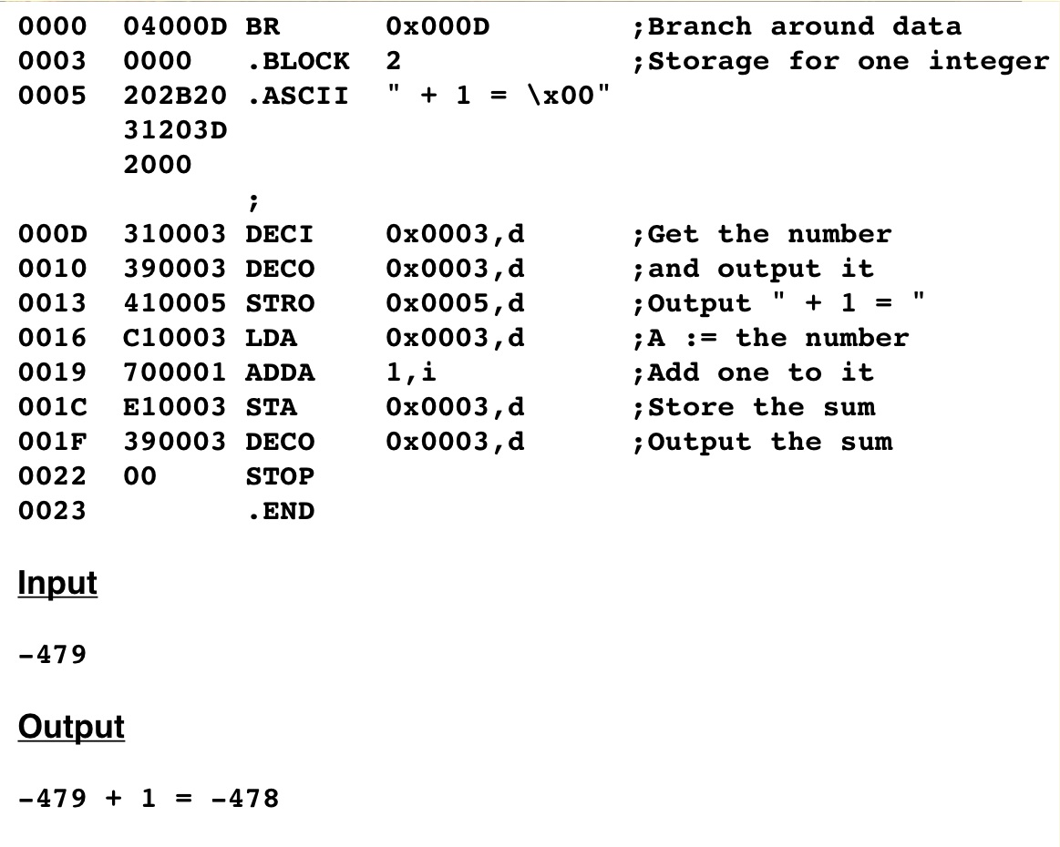
Fig. 5.12: A program that interprets a value as decimal and as hexadecimal
Notes:
In this program, the red box shows how the string is saved into memory.
The green box shows how STRO outputs the string.

Slide 19
Interpreting Bit Patterns
Remember –
CPU has no knowledge of what bits mean
Next slide demonstrates this
Notes:
Remember the CPU is processing bits. It does not know (or care) what they represent.
The next slide demonstrates this.

Slide 20
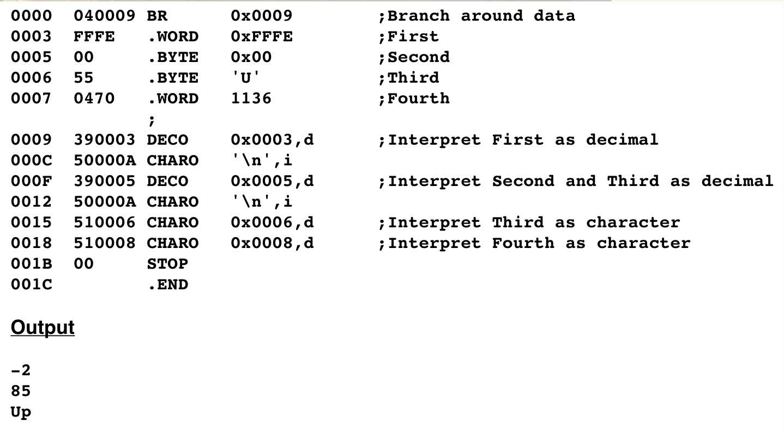
Interpreting Bit Patterns
Generated as Hex
Output as decimal
Interprets 2 bytes at address 05 as decimal. Prints the number 85.
Interprets the number at address 0008 as a character. The number placed in address 0007 and 0008 is 1136 or 0470(hex). 70 is ASCII for 'p'.
Notes:
<click>
The first example, shows a word that is input as hex FFFE.
When this is output with DECO, it is converted to decimal -2
<click>
The second example, inputs 2 bytes – hex 00 and the ascii character upper case U
When this is output with DECO, it is converted to decimal 85 !! (Note upper case U is 55 hex which equals 85 decimal)
<click>
The third character, an upper case U is input and output as expected.
<click>
In the third example, the decimal number 1136 (0470 hex) is input.
When this is output with CHARO, it is converted to an ASCII letter p !!
The computer will do as it is told is even more meaningful at this level of programming.

Slide 21
Disassemblers
Assembler
translates each assembly language statement into exactly one machine language statement
One-to-one mapping
Given a single assembly language statement, can always determine the corresponding machine language statement
Notes:
This may seem like an odd time to discuss disassemblers, however the last slide will help you understand this now.
An assembler translates each assembly language statement into exactly one machine language statement
It has One-to-one mapping. In other words, given a single assembly language statement, one can always determine the corresponding machine language statement.

Slide 22
Disassemblers
Inverse not true
Example: 0101 0111
Is this a .ASCII with character W?
Or the CHARO mnemonic (stack-indexed deferred addressing)?
Same bits!
CPU knows nothing about the assembly statements
Next slide: two programs that produce same machine language and output.
Notes:
Given a single machine language statement, there is not always a unique assembly language statement.
In this example, 0101 0111 can be interpreted two different ways depending whether it is data or an instruction.

Slide 23
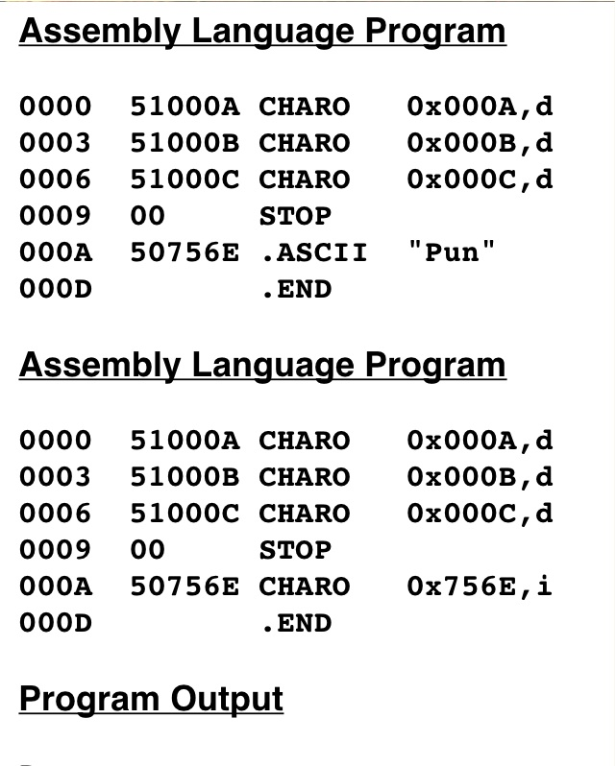
Disassemblers
Two assembly language programs that produce the same object code and, therefore, the same output
Pun
Notes:
Here you can see that these two assembly language instructions produce the same machine code and the same output.

Slide 24
Disassemblers
Problem: pseudo-ops insert bit patterns
If there were no pseudo-ops there would be a one-to-one mapping
Root problem:
Data and instructions share memory
Programmers can sell machine code and buyers cannot change
Open-source software movement: give away the source code with the program
Companies get income by supporting the product
Customer can view code for security reasons and make bug fixes themselves
Notes:
The problem is that pseudo-ops insert bit patterns
If there were no pseudo-ops there would be a one-to-one mapping
The root problem is that data and instructions share memory and make it difficult to decode the machine code.
This is an advantage for software developers because programmers can sell machine code and buyers cannot change it.
In the past several years there has been an open-source software movement: give away the source code with the program
Customer can view code for security reasons and make bug fixes their self. Linux is an example of this strategy.

Slide 25
Disassemblers
Disassembler: a program that tries to recover the source program from the object program
Can never be 100% successful.
In large program data is scattered throughout the program.
Disassembler reads each byte and prints it out several times
Once as instruction
Once as ASCII
Once as 2’s complement
People must reconstruct the program
Notes:
A Disassembler is a program that tries to recover the source program from the object program
As we have seen it can never be 100% successful.
In a large program, data is scattered throughout the program.
Disassembler reads each byte and prints it out several times
Once as instruction
Once as ASCII
Once as 2’s complement
People must reconstruct the program, though it is difficult.

Slide 26
Symbols
Problem: to know where data begins, must determine addresses
Problem 2: if you remove data (eg a .WORD command), all addresses change
Solution: symbols
Instead of using addresses (at assembly level) can use symbols.
Every time you assemble the program, assembler recalculates the addresses
Notes:
Now, let’s go back to the problems with assembly that we identified.
If we insert or remove a line, all the addresses change.
The solution is to use a symbols that is associated with a memory address.
Then when the program is assembled, the assembler recalculates the adresses.

Slide 27
Symbols
Rules:
First char must be a letter
Following char must be letters or numbers
Max of 8 char long
Case sensitive
Define by placing the symbol at beginning of line
Must terminate definition with a colon ( : )
No spaces between last char of symbol and colon
Notes:
Here are the rules for symbols:
The first char must be a letter
Following char must be letters or numbers
Max of 8 char long
Case sensitive
Define by placing the symbol at beginning of line.
Must terminate definition with a colon ( : )
No spaces between last char of symbol and colon.

Slide 28
Symbols
Example:
Define the symbol num as address for a block of two bytes
num: .BLOCK d#2
Use the symbol to reference the address
do not use the colon
DECI num,d ; get the number
Notes:
Here the symbol num: is defined as the address of the first byte of the block of two bytes.
The DECI instruction references that address by using the symbol num – with no colon.

Slide 29
Symbol Tables
Assembler detects a symbol definition: stores the symbol and its value in a symbol table
The value of the symbol is the address in memory where the first byte of the object code generated from that line will be loaded.
If you define symbols, the assembler listing will print out the symbol table
2 pass assembler
Notes:
When an assembler detects a symbol definition, stores the symbol and its value in a symbol table.
The value of the symbol is the address in memory where the first byte of the object code generated from that line will be loaded.
If you define symbols, the assembler listing will print out the symbol table.
This requires a 2 pass assembler. In the first pass it stores all the symbols and their values. In the second pass it, replaces all the symbol references with the address value.

Slide 30
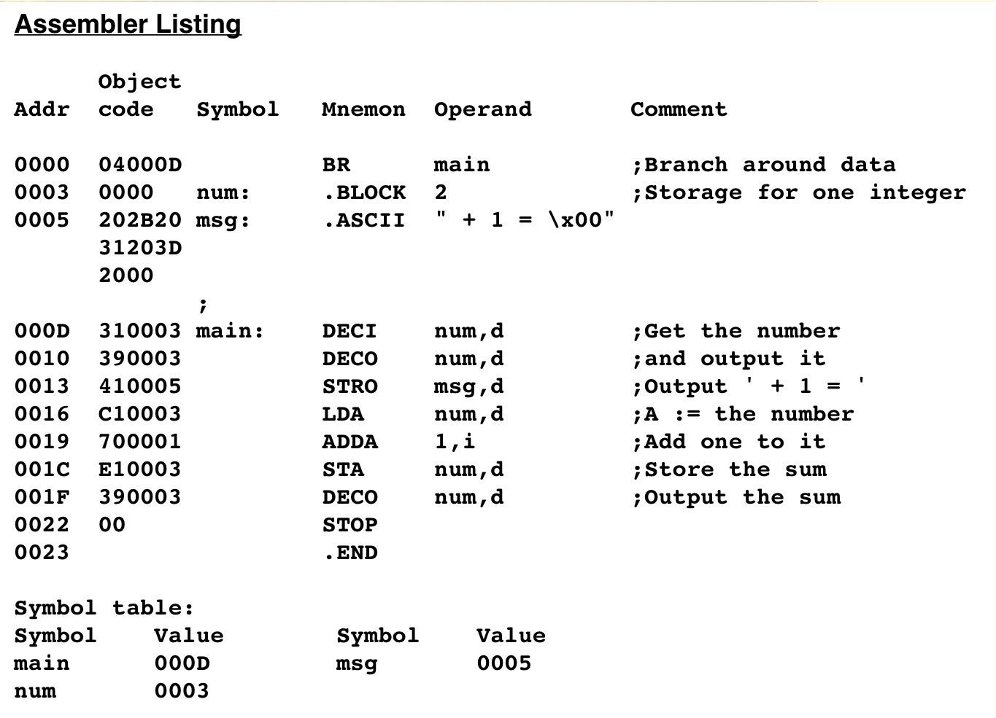
A program to add 1 to a decimal value
Replaced with BR 0x000D.
Note that there is no colon here.
Replaced with DECI 0x0003,d
Note that there is no colon here.
5-30
Notes:
<click>
Here we see that the symbol main represents address 000D so that is assigned to the Branch instruction on the first line.
This will change the Program counter to 000D for the next instruction.
<click>
On this line, we see that the symbol num is assigned to the data storage address 0003, so that is assigned to the DECI instruction to store data there.
At the bottom is the symbol table listing the current address assignment for each symbol.

Slide 31
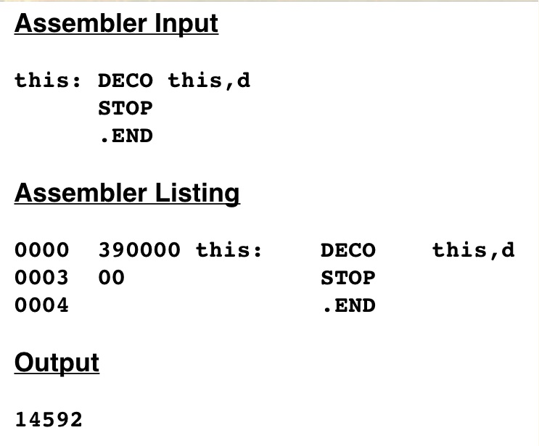
A nonsense program that illustrates the underlying von Neumann nature of the machine
What happens here?
Notes:
Woah – In this example the symbol ‘this’ is both the address and the operand. Can you figure out what happens here?
‘this’ represents the address 0000.
So the instruction DECO gets the word ( 2 bytes) from memory location 0000 which is 3900 hex and outputs it as a decimal number which is 14592.
Remember - the computer just operates on bits – It does not distinguish between data and instructions.
( I think you have heard that before!)
That is the end of this presentation. Please review all of the lectures before taking the quiz for Chapter 5.

